Slide 1
Lab 1 Mininet/ONOS Installation

Slide 2
Installation
Check the following website
https://hackmd.io/_YRqnX0WSdmzGSQ68ObnUg?view

Slide 3
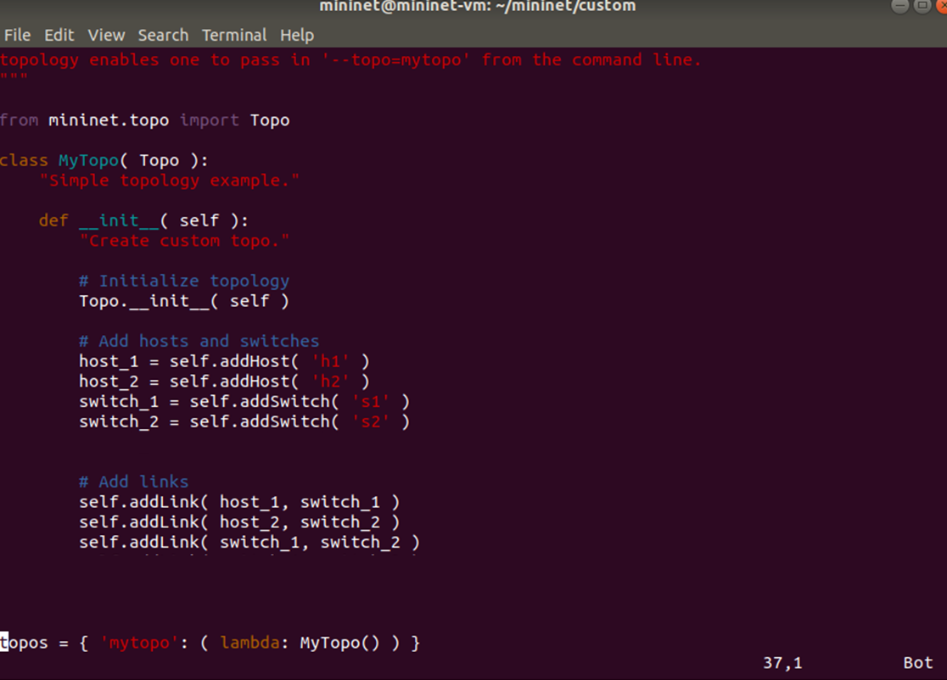
test.py

Slide 4



Topology

Slide 5
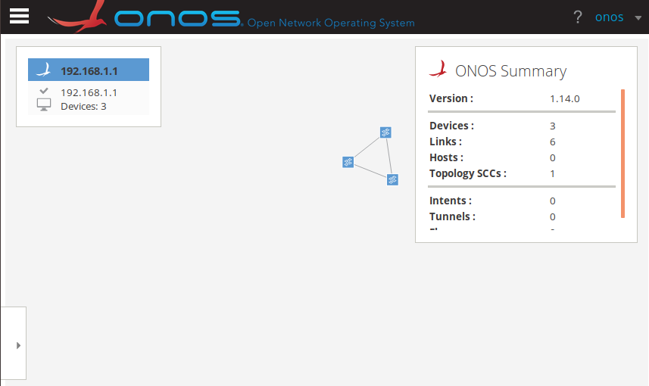
Topology via Web Page
http://localhost:8181/onos/ui/index.html
Login/password = onos/rocks

Slide 6
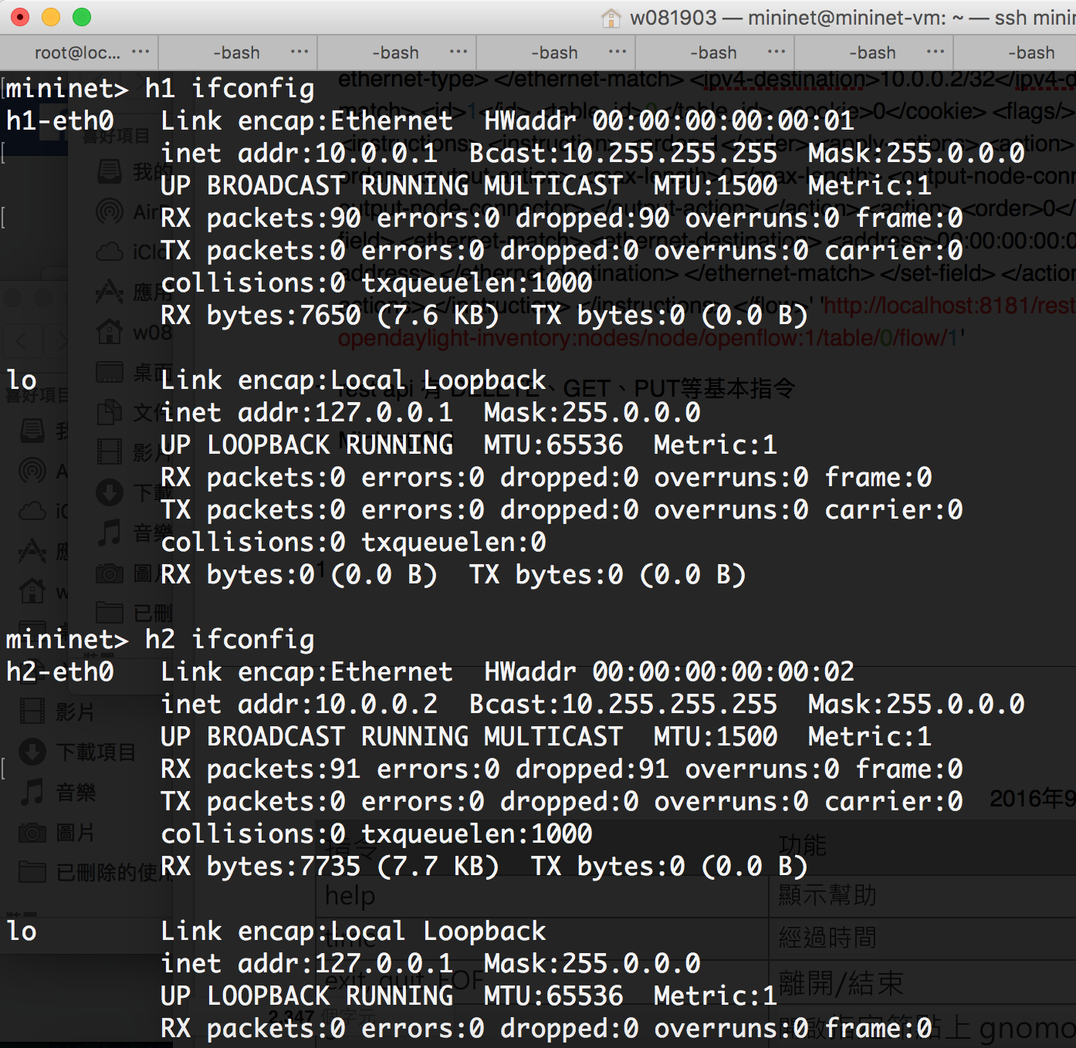
Mininet test
In mininet environment we can use h1 ifconfig to check what h1’s ip address it is.

Slide 7
Install flow to vSwitch
We can use Rest API to install flow from controller to vswitch
curl -X POST -H "content-type:application/json" http://localhost:8181/onos/v1/flows/of:0000000000000001 -d @./test_1.json --user onos:rocks
Switch ID
Json file for the rule

Slide 8
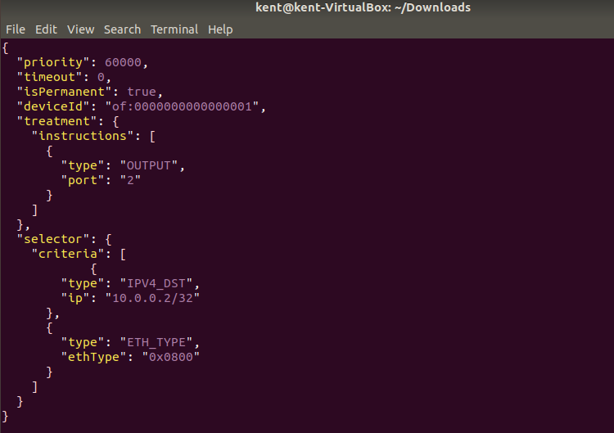
Install flow to vSwitch
Action (how to process the packet)
The packet we want to match

Slide 9
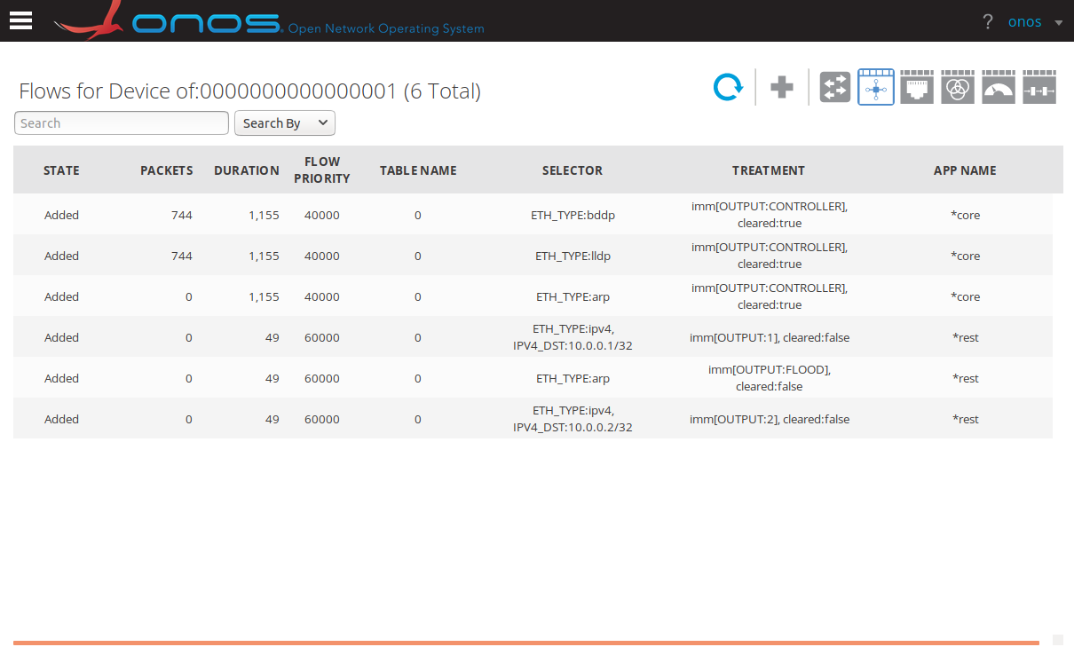
Check Flow
ONOS web site
The flow which we add

Slide 10
Test Traffic
Use iperf or ping
h1 ping h2
iperf

Slide 11
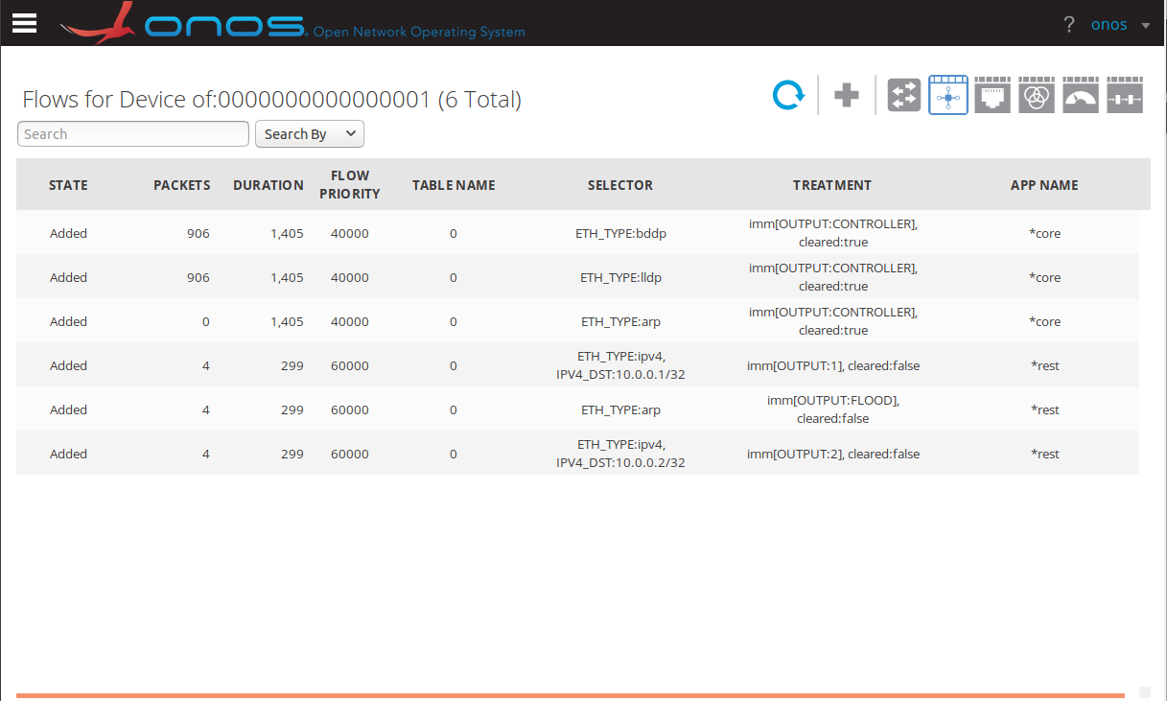
Check Flow
Use sh ovs-ofctl dump-flows -O OpenFlow13 s1
The number of packets matching the rules

Slide 12
Homework
產生有兩條路徑的topology
h1 ping h2
讓ping packet走較長的路徑
在moodle上傳三張螢幕截圖:
Switch s3的forwarding table
Ping 成功的畫面
ONOS GUI中的topology
Due: 11/5, 2020 (THU.)

Slide 13
Topology

Slide 14
reference
ONOS and mininet
http://www.stackguy.com/archives/248
json for rule
https://wiki.onosproject.org/display/ONOS/Flow+Rules
curl to install rules
https://wiki.onosproject.org/display/ONOS/REST

